Slide 1

Data Driven Design of Load Bearing Components Bachelor of Technology Project Thesis (Semester V)
Atharva Malwadkar (180103015) and Devanuj Baruah (180103023)
Under the Supervision of
Dr Debabrata Chakraborty and Dr Shyamanta M Hazarika
DEPARTMENT OF MECHANICAL ENGINEERING
INDIAN INSTITUTE OF TECHNOLOGY GUWAHATI
(Nov 2020)

Slide 2
Introduction
In mechanical design, the focus is mainly on the design of load bearing components with an objective of determining optimum size, shape and material ensuring safety of the component under the load. Therefore, historically, a mechanical design process has always been undertaken using relevant constitutive models.
These constitutive models have been important for structural design and material certification, and are traditionally achieved through mostly uniaxial tests aiming in the determination of elastic material properties primarily.

Slide 3
Limitations of constitutive modelling
Constitutive models have their own limitations.
When dealing with complex problems for systems with high dimensional design variables, these models are complex and slow to process.
In certain instances, the design domain is far too big to be processed by a constitutive model. The nonexistence of knowledge of a design problem also makes getting to the correct constitutive model almost impossible.

Slide 4
Motivation
Our motivation is to propose Data-Driven design as a way to eliminate these epistemic uncertainties linked to traditional constitutive models in mechanical design.
A model free data driven approach can not only eliminate the explicit postulation of a specific constitutive model, it also generates databases of material states for sampling.
Further, for orthosis and prostheses, the designs that are data – driven are more engaging and tailored to users’ preferences.

Slide 5

Data Driven Design process

Slide 6
Literature Review
Liu et al. [1] presented a detailed review of applying machine learning in materials science in their paper “Materials discovery and design using machine learning”, where the main algorithms have been classified and compared. They have also reviewed the current research status with regard to applications of machine learning in material property prediction, in new materials discovery. Finally, they discussed the problems related to machine learning in materials science and proposed possible solutions along with the potential directions of future research.
Charlotte et al. [2] addressed the problem of identifying an osteoarthritic glenoid from a wide range of variability among population in their paper “Modeling the Variability of Glenoid Geometry in Intact and Osteoarthritic Shoulders”. The main focus of their work was to create a model with existing mathematical and statistical modeling approaches to present the structure of a Glenoid in a different way to critically analyze it and contribute to the counter the complications in Total Surgical Arthroplasty

Slide 7
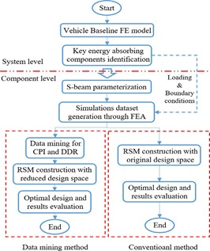
Hongzhan et al. [3] in their paper “An Integrated Approach for Design Improvement Based on Analysis of Time-Dependent Product Usage Data” discuss in detail about the transformation of product usage data, including product time-dependent performance feature data and field data, 7 into valuable information to guide product design improvement, so that design and manufacturing engineers can better identify design defectives and improve product reliability.
Du and Zhu [4] undertook a study in their paper “A new data-driven design methodology for mechanical systems with high dimensional design variables” with the aim of developing a novel methodology for system with high-dimensional design variables, based on data mining theory. It is implemented through designing a crashworthy passenger car, which is a multi-level (system – components) complicated system. The design alternatives designed by Finite Element analysis when subjected to pre-defined constraints.

Slide 8
Stainier et al [5] propose an integrated model-free data-driven approach to solid mechanics in their paper “Model-free data-driven methods in mechanics: material data identification and solvers” and show how principles and techniques of data driven computational mechanics leads to elimination of epistemic uncertainty linked to traditional constitutive models.
Tien-Thinh Le [6] discusses a study in their paper “Surrogate Neural Network Model for Prediction of LoadBearing Capacity of CFSS Members Considering Loading Eccentricity” where a surrogate Machine Learning (ML)- based model was developed, to predict the load-bearing capacity (LBC) of concretefilled steel square hollow section (CFSS) members, considering loading eccentricity. Error measurement criteria: coefficient of determination (R2), slope of regression, root mean square error (RMSE) and mean absolute error (MAE)

Slide 9
Gap in literature and objectives of present work
Literature review reveals that data driven design methodology has been an important research area in recent years especially with the availability of high capacity digital computers.
However, there has been a scope of using data driven design in mechanical design in particular.
With this back ground, this project proposes to explore machine learning algorithms to put forward an integrated model-free data-driven approach to mechanical design problems, without postulating a specific constitutive model

Slide 10
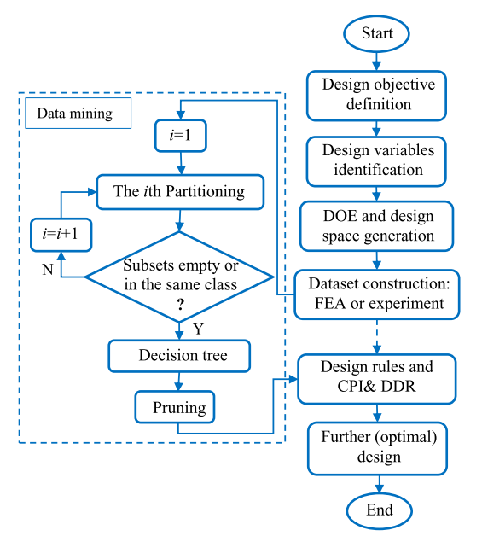
Methodology
Critical Parameter Identification (CPI)

Slide 11
The previous image showcases the flowchart of the data mining method to design a system with high-dimensional design variables. In the first step, the design problem is analyzed and the design objective is determined. Likewise, the design variables are further identified and the range of their values are determined. Then, in the design space, a large number of design of experiments (DOEs) are built. Each design is computed through FEA and the simulation results form a large design dataset. After that, data mining is performed on the simulation dataset to construct a 13 decision tree, with which CPI and DDR can be implemented simultaneously to reduce the design space. Likewise, useful inter-relationships among design variables and decision making rules can be derived.

Slide 12
Based on this information and reduced design space, the further optimal design can be achieved faster and at lower cost. In the data mining process, the recursive partitioning on the simulation dataset (the initial design space) is conducted to construct the decision tree.
DECISION TREE ALGORITHM:
The gain ratio of entropy is first calculated for the whole dataset to determine the first (i = 1) partitioning. If all subsets after this operation are empty or belong to the same class, the decision tree construction is complete. Otherwise, a new round of partitioning is performed (i = i + 1) on the impure subsets and each of these impure subsets includes more than one class. The procedure is repeated in this recursive way until all subsets are empty or in the same class. After the decision tree is built, it is pruned to obtain more concise results. Using this decision tree, design rules are derived, and then CPI and DDR are carried out to achieve the final design.

Slide 13
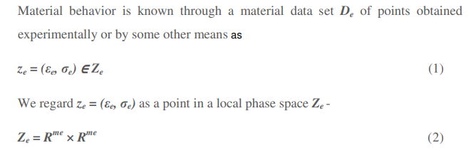
MODEL-FREE MATERIAL DATA IDENTIFICATION
We propose to achieve the removal of uncertainty of constitutive models through a model-free data driven technique, which would be used for the identification of the material data-set.
Using ML algorithms such as K-means, for each material point we converge on a mechanical state under equilibrium (Data Driven Identification)
Our aim is to subsequently apply a Euclidean distance minimization algorithm to converge on a compatible material state space (of stress-strain), thus formulating a boundary value problem directly in terms of material data.

Slide 14
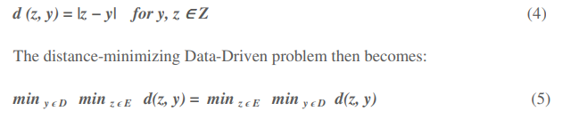
A class of Data-Driven problems consists of finding the compatible and equilibrated internal state z ∈ E that minimizes the distance to the global material data set D = D1 ×···× DM, the associated distance ‘d’ being:
we wish to find the point y ∈ D in the material data set that is closest to the constraint set E of compatible and equilibrated internal states

Slide 15
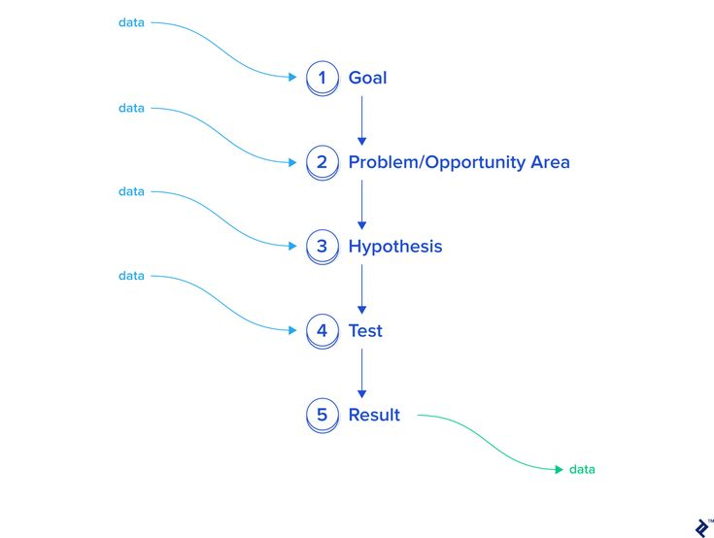
Data flow in design:
In this discussion we have seen how a data-driven approach to design is devoid of any form of traditional modelling. Instead, as shown in the previous figure, data is sequentially used to process and give design insight. The actualization of a goal, identification of the and formulation of the hypothesis, use algorithms to manipulate experimental or synthetic data, which provides us design optimization based on data analysis, rather than having to invoke empirical relations and conventional models.

Slide 16
Conclusion
Literature review has been performed to understand the data driven design concept in general and to understand the state of the art in the data driven design approach with special focus on the data driven mechanical design. From the thorough review of literature, the potential of data driven methodology as more efficient approach in obtaining the desired solutions bypassing the constitutive models could be observed. It is clear that such methodologies can be applied for numerous other mechanical design problems where the constitutive models have limitations in the form of not producing results under our desired constraints

Slide 17
Work Ahead
Next Semester:
Generate large amount of synthetic data for a mechanical design problem using FEM
Apply data driven methodology to extract with force deformation response.
Compare different algorithms to understand the best methodology
Formulate a precise design methodology by the relevant integration of aforementioned algorithms, suitably devised to meet the design requirements
Based on the outcome of the next semester, details work plan for next two semesters (7th and 8th) will be planned.

Slide 18
References
[1] Yue Liu, Tianlu Zhao, Wang wei,Ju, Siqi Shi, “Materials discovery and design using machine learning”, Journal of Materiomics, Volume 3, Issue 3, September 2017, Pages 159-1
[2] Charlotte M. de, Matthew B. Parkinson, “Modeling the Variability of Glenoid Geometry in Intact and Osteoarthritic Shoulders” [DOI: 10.1115/1.4037408]
[3] Ma Hongzhan, Xuening Chu, Guolin Lyu, Deyi Xue, “An Integrated Approach for Design Improvement Based on Analysis of Time-Dependent Product Usage Data” July 2017 Journal of Mechanical Design 139(11), DOI: 10.1115/1.4037246
[4] Xianping Du, Feng Zhu, “A new data-driven design methodology for mechanical systems with high dimensional design variables”, Department of Mechanical Engineering, Embry-Riddle Aeronautical University, Daytona Beach, FL 32114, USA
[5] Laurent Stainier, Adrien Leygue, Michael Ortiz, “Model-free data-driven methods in mechanics: material data identification and solvers” Published online: 4 June 2019, © Springer-Verlag GmbH Germany
[6] Tien-Thinh Le, “Surrogate Neural Network Model for Prediction of LoadBearing Capacity of CFSS Members Considering Loading Eccentricity” Published: 16 May 2020
[7] Zhinan Zhang, Ling Liu, Wei Wei, Fei Tao, Tianmeng Li, Ang Liu, “A Systematic Function Recommendation Process for Data-Driven Product and Service Design”, J. Mech. Des. Nov 2017

Slide 19
THANK YOU

